Slide 1
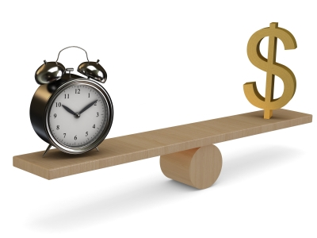
Project Estimation
Estimating is the process of forecasting or approximating the time and cost of completing project deliverables.

Slide 2
Why Estimating Time and Cost Are Important
• Estimates are needed to support good decisions.
• Estimates are needed to schedule work.
• Estimates are needed to determine how long the project should take and its cost.
• Estimates are needed to determine whether the project is worth doing.
• Estimates are needed to develop cash flow needs.
• Estimates are needed to determine how well the project is progressing.
• Estimates are needed to develop time-phased budgets and establish the project baseline.
Top-Down Estimation
Bottom-Up Estimation

Slide 3

Top-Down Estimation
Usually done by senior management
Analogy
Group Consensus
Mathematical Relationship

Slide 4

Bottom-Up Estimation
Performed by the people who are doing the work

Slide 6
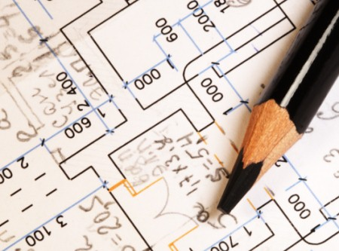
Factors influencing the quality of Estimate
Planning Horizon
Project Duration
People
Project Structure and Organisation
Padding Estimates
Organisation Culture
Notes:
Planning Horizon The quality of the estimate depends on the planning horizon; estimates of current events are close to 100 percent accurate but are reduced for more distant events. The accuracy of time and cost estimates should improve as you move from the conceptual phase to the point where individual work packages are defined.
Project Duration Time to implement new technology has a habit of expanding in an increasing, nonlinear fashion. Sometimes poorly written scope specifications for new technology result in errors in estimating times and costs. Long-duration projects increase the uncertainty in estimates.
People The people factor can also introduce errors in estimating times and cost. For example, accuracy of estimates depends on the skills of the people making the estimates. A close match of people skills to the task will influence productivity and learning time. Similarly, whether members of the project team have worked together before on similar projects will influence the time it takes to coalesce into an effective team. Sometimes factors such as staff turnover can influence estimates. It should be noted that adding new people to a project increases time spent communicating. Typically, people have only five to six productive hours available for each working day; the other hours are taken up with indirect work, such as meetings, paperwork, answering e-mail.
Project Structure and Organization Which project structure is chosen to manage the project will influence time and cost estimates. One of the major advantages of a dedicated project team discussed earlier is the speed gained from concentrated focus and localized project decisions. This speed comes at an additional cost of tying up personnel full time. Conversely, projects operating in a matrix environment may reduce costs by more efficiently sharing personnel across projects but may take longer to complete since attention is divided and coordination demands are higher.
Padding Estimates In some cases people are inclined to pad estimates. For example, if you are asked how long it takes you to drive to the airport, you might give an average time of 30 minutes, assuming a 50/50 chance of getting there in 30 minutes. If you are asked the fastest you could possibly get there, you might reduce the driving time to 20 minutes. Finally, if you are asked how long the drive would take if you absolutely had to be there to meet with the president, it is likely you would increase the estimate to say 50 minutes to ensure not being late. In work situations where you are asked for time and cost estimates, most of us are inclined to add a little padding to increase the probability and reduce the risk of being late. If everyone at all levels of the project adds a little padding to reduce risk, the project duration and cost are seriously overstated. This phenomenon causes some managers or owners to call for a 10–15 percent cut in time and/or cost for the project. Of course the next time the game is played, the person estimating cost and/or time will pad the estimate to 20 percent or more. Clearly such games defeat chances for realistic estimates, which is what is needed to be competitive.
Organization Culture Organization culture can significantly influence project estimates. In some organizations padding estimates is tolerated and even privately encouraged. Other organizations place a premium on accuracy and strongly discourage estimating gamesmanship. Organizations vary in the importance they attach to estimates. The prevailing belief in some organizations is that detailed estimating takes too much time and is not worth the effort or that it’s impossible to predict the future. Other organizations subscribe to the belief that accurate estimates are the bedrock of effective project management. Organization culture shapes every dimension of project management; estimating is not immune to this influence. Other Factors Finally, nonproject factors can impact time and cost estimates. For example, equipment down-time can alter time estimates. National holidays, vacations, and legal limits can influence project estimates. Project priority can influence resource assignment and impact time and cost. Project estimating is a complex process. The quality of time and cost estimates can be improved when these variables are considered in making the estimates. Estimates of time and cost together allow the manager to develop a time-phased budget, which is imperative for project control. Before discussing macro and micro estimating methods for times and costs, a review of estimating guidelines will remind us of some of the important “rules of the game” that can improve estimating.

Slide 7
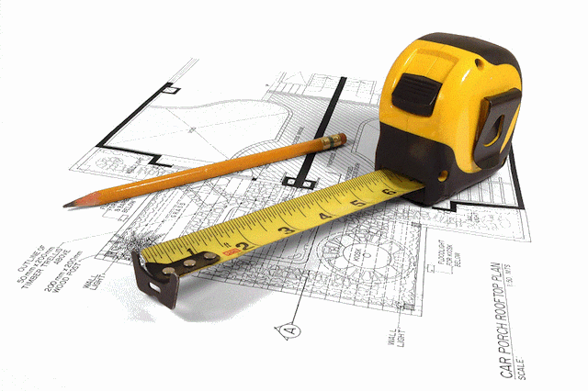
Guidelines for Estimation
Responsibility
Use Several People to estimate
Normal Conditions
Time Units
Independences
Contingencies
Adding Risk Assessment to helps to avoid surprise to stakeholders
Notes:
Responsibility. At the work package level, estimates should be made by the person(s) most familiar with the task. Draw on their expertise! Except for supertechnical tasks, those responsible for getting the job done on schedule and within budget are usually first-line supervisors or technicians who are experienced and familiar with the type of work involved. These people will not have some preconceived, imposed duration for a deliverable in mind. They will give an estimate based on experience and best judgment. A secondary benefit of using those responsible is the hope they will “buy in” to seeing that the estimate materializes when they implement the work package. If those involved are not consulted, it will be difficult to hold them responsible for failure to achieve the estimated time. Finally, drawing on the expertise of team members who will be responsible helps to build communication channels early.
Use several people to estimate. It is well known that a cost or time estimate usually has a better chance of being reasonable and realistic when several people with relevant experience and/or knowledge of the task are used. True, people bring different biases based on their experience. But discussion of the individual differences in their estimate leads to consensus and tends to eliminate extreme estimate errors. This approach is similar to the Delphi estimating method, which can also be used.
Normal conditions. When task time, cost, and resource estimates are determined, they are based on certain assumptions. Estimates should be based on normal conditions, efficient methods, and a normal level of resources. Normal conditions are sometimes difficult to discern, but it is necessary to have a consensus in the organization as to what normal conditions mean in this project. If the normal workday is eight hours, the time estimate should be based on an eight-hour day. Similarly, if the normal workday is two shifts, the time estimate should be based on a two-shift workday. Any time estimate should reflect efficient methods for the resources normally available. The time estimate should represent the normal level of resources— people or equipment
Time units. Specific time units to use should be selected early in the development phase of the project network. All task time estimates need consistent time units. Estimates of time must consider whether normal time is represented by calendar days, workdays, workweeks, person days, single shift, hours, minutes, etc. In practice the use of workdays is the dominant choice for expressing task duration. However, in projects such as a heart transplant operation, minutes probably would be more appropriate as a time unit. One such project that used minutes as the time unit was the movement of patients from an old hospital to an elegant new one across town. Since there were several life-endangering moves, minutes were used to ensure patient safety so proper emergency life-support systems would be available if needed. The point is, network analysis requires a standard unit of time. When computer programs allow more than one option, some notation should be made of any variance from the standard unit of time. If the standard unit of time is a five-day workweek and the estimated activity duration is in calendar days, it must be converted to the normal workweek.
Independence. Estimators should treat each task as independent of other tasks that might be integrated by the WBS. Use of first-line managers usually results in considering tasks independently; this is good. Top managers are prone to aggregate many tasks into one time estimate and then deductively make the individual task time estimates add to the total. If tasks are in a chain and performed by the same group or department, it is best not to ask for all the time estimates in the sequence at once to avoid the tendency for a planner or a supervisor to look at the whole path and try to adjust individual task times in the sequence to meet an arbitrary imposed schedule or some rough “guesstimate” of the total time for the whole path or segment of the project. This tendency does not reflect the uncertainties of individual activities and generally results in optimistic task time estimates. In summary, each task time estimate should be considered independently of other activities.
Contingencies. Work package estimates should not include allowances for contingencies. The estimate should assume normal or average conditions even though every work package will not materialize as planned. For this reason top management needs to create an extra fund for contingencies that can be used to cover unforeseen events.
Adding risk assessment to the estimate helps to avoid surprises to stakeholders. It is obvious some tasks carry more time and cost risks than others. For example, a new technology usually carries more time and cost risks than a proven process. Simply identifying the degree of risk lets stakeholders consider alternative methods and alter process decisions. A simple breakdown by optimistic, most likely, and pessimistic for task time could provide valuable information regarding time and cost.

Slide 8
Conditions for Preferring Top-Down or Bottom-Up Time and Cost Estimates

Slide 9

Top-Down approaches for Estimation
Used to evaluate project proposal
Much information may not be available at the initial phase of the project.
Eg: Design is not finalised
Used until tasks in WBS are clearly defined

Slide 10

Consensus
Uses experience of senior and/or middle managers
Discuss
Argue
Estimate
Meeting

Slide 12

Ratio Methods
Square feet
Capacity size

Slide 13
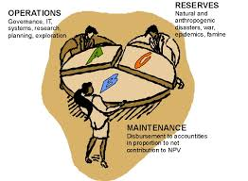
Apportion Methods
Extension of ratio method by using historical data
Quick estimate little effort with reasonable accuracy

Slide 15

Learning Curves
Time to perform a task improves with repetition
Especially true for labour intensive work

Slide 16

Disadvantages of Top-Down Approach
Time and cost of a specific tasks are not considered
Grouping many tasks into a common basket encourages errors of omission

Slide 17
Bottom-Up Approaches for Estimating Project Times and Costs
Template Methods
Parametric Procedures Applied to Specific Tasks
Range Estimating

